Slide 1
Advanced Analysis of Algorithms
Deep Learning Algorithms For Face Detection
Aman Hasan Shaik
50489517
Himaja Kotturu
50490169

Slide 2
Overview
Deep Learning
1
Convolutional Neural Networks
2
Brute Force Idea
3
How Convolution Works
4
Face Recognition with Deep Learning
5

Slide 3
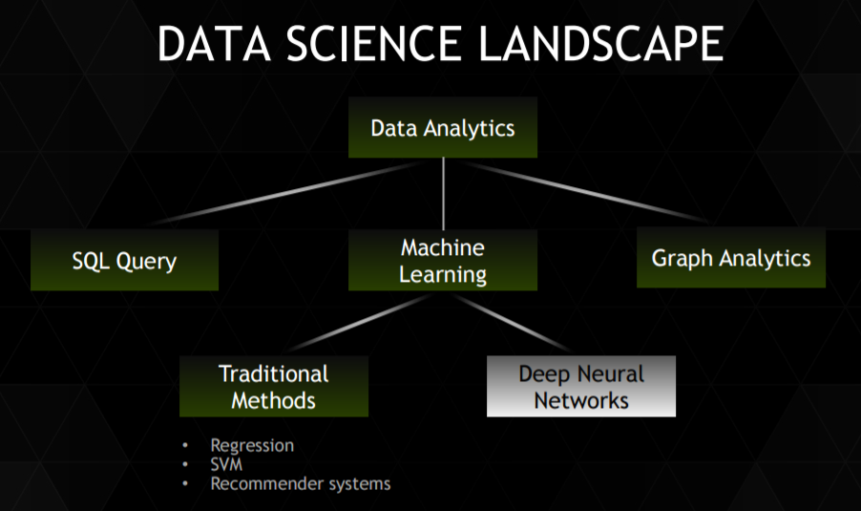
Deep Learning
Train networks with many layers (vs. shallow nets with just a couple of layers)
Multiple layers work to build an improved feature space
First layer learns 1st order features (e.g. edges…)
2nd layer learns higher order features (combinations of first layer features, combinations of edges, etc.)
Some models learn in an unsupervised mode and discover general features of the input space – serving multiple tasks related to the unsupervised instances (image recognition, etc.)
Final layer of transformed features are fed into supervised layer(s)
And entire network is often subsequently tuned using supervised training of the entire net, using the initial weightings learned in the unsupervised phase.

Slide 4
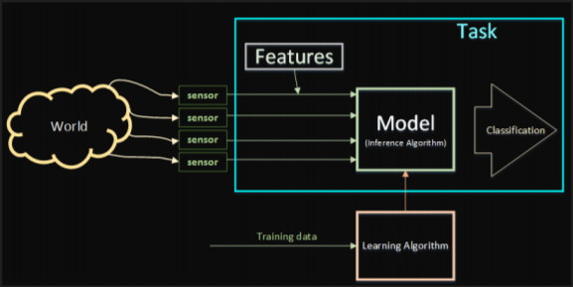
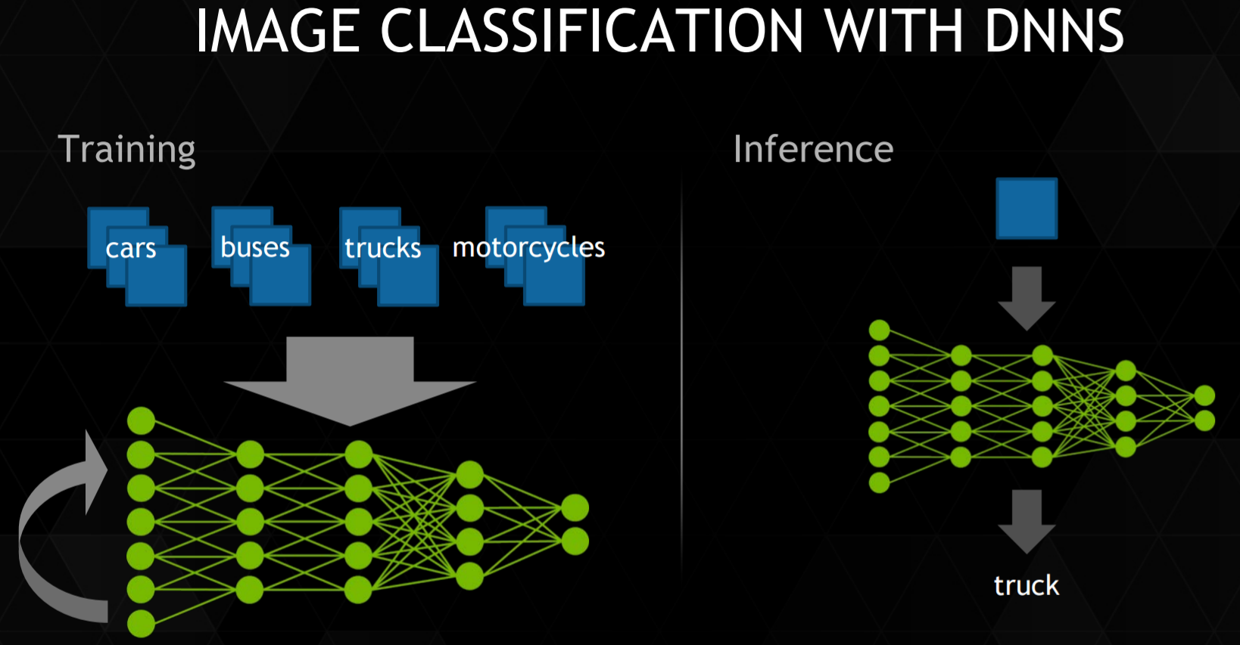
Deep Learning
Systems that learn to recognize objects that are important, without us telling the system explicitly what that object is ahead of time
Key components
Task
Features
Model
Learning Algorithm
Typical training run
Pick a DNN design
Input 100 million training images spanning 1,000 categories
One week of computation
Test accuracy
If bad: modify DNN, fix training set or update training parameters

Slide 5
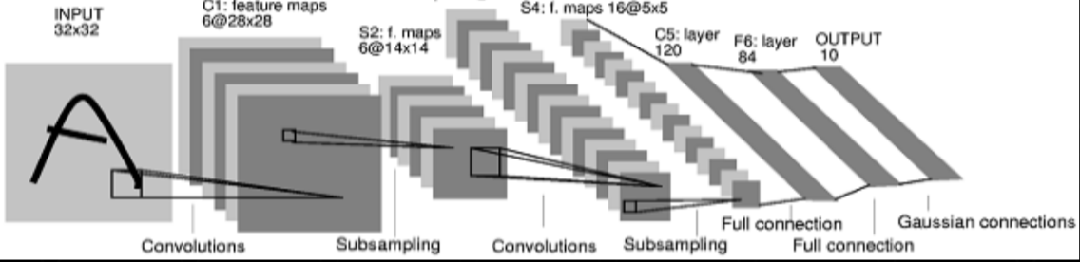
CONVOLUTIONAL NEURAL NETWORKS
Biologically inspired.
Neuron only connected to a small region of neurons in layer below it called the receptive field.
A given layer can have many convolutional filters/kernels. Each filter has the same weights across the whole layer.
Bottom layers are convolutional, top layers are fully connected.
Generally trained via supervised learning.
Supervised
Unsupervised
Reinforcement
…ideal system automatically switches modes…

Slide 6
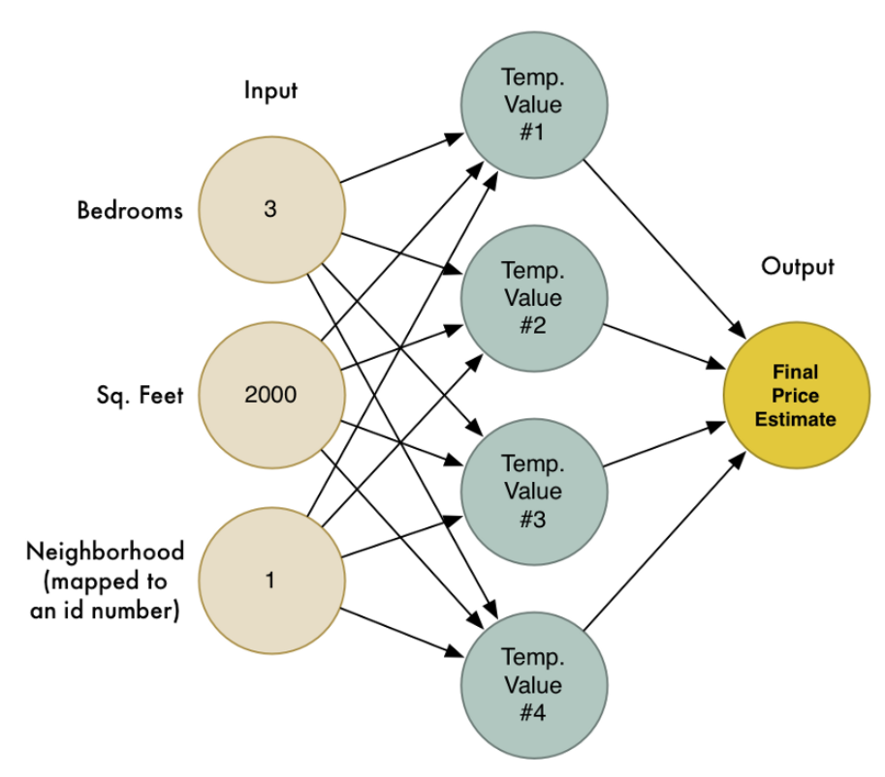
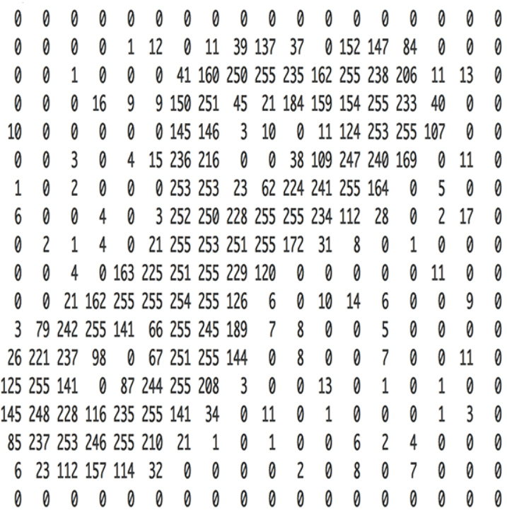

Starting Simple
Neural networks can solve complex problems by chaining together lots of simple neurons. We created a small neural network to estimate the price of a house based on how many bedrooms it had, how big it was, and which neighborhood it was in.
We also know that the idea of machine learning is that the same generic algorithms can be reused with different data to solve different problems. So let’s modify this same neural network to recognize handwritten text. But to make the job really simple, we’ll only try to recognize one letter — the numeral “8”.
The answer is incredible simple. A neural network takes numbers as input. To a computer, an image is really just a grid of numbers that represent how dark each pixel is.

Slide 7
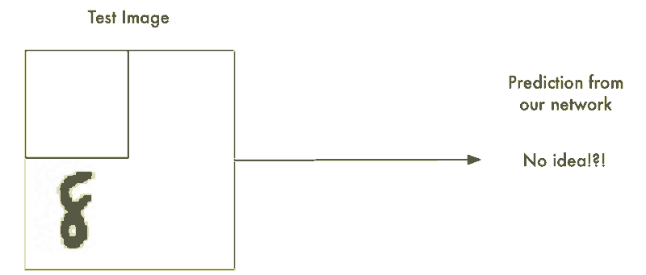
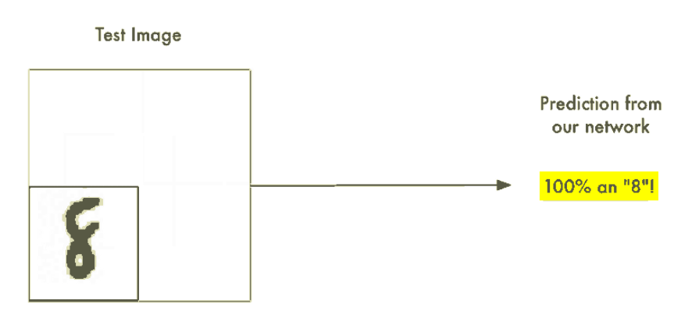
Brute Force Idea : Searching with a Sliding Window
We already created a really good program for finding an “8” centered in an image. What if we just scan all around the image for possible “8”s in smaller sections, one section at a time, until we find one.
This approach called a sliding window. It’s the brute force solution. It works well in some limited cases, but it’s really inefficient. You have to check the same image over and over looking for objects of different sizes. We can do better than this.

Slide 8
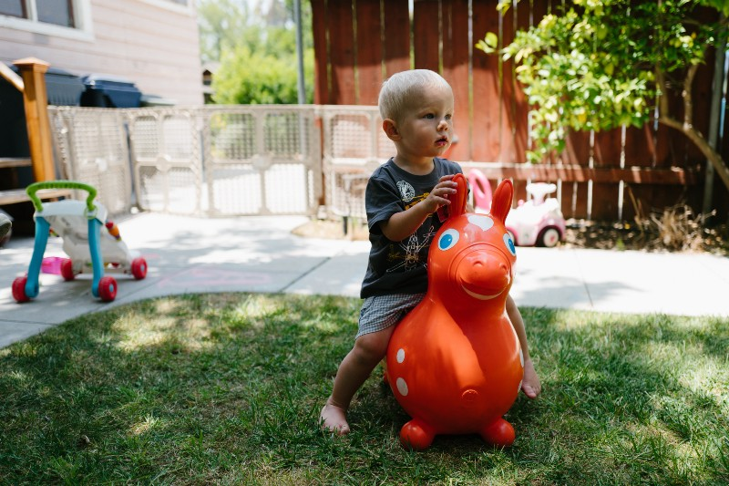
How Convolution Works
As a human, you intuitively know that pictures have a hierarchy or
conceptual structure. Consider this picture,
As a human, you instantly recognize the hierarchy in this picture:
The ground is covered in grass and concrete
There is a child
The child is sitting on a bouncy horse
The bouncy horse is on top of the grass
Most importantly, we recognize the idea of a child no matter what surface the child is on. We don’t have to re-learn the idea of child for every possible surface it could appear on.
We’ll do this using a process called Convolution. The idea of convolution is inspired partly by computer science and partly by biology (i.e. mad scientists literally poking cat brains with weird probes to figure out how cats process images). Instead of feeding entire images into our neural network as one grid of numbers, we’re going to do something a lot smarter that takes advantage of the idea that an object is the same no matter where it appears in a picture. Here’s how it’s going to work, step by step .

Slide 9
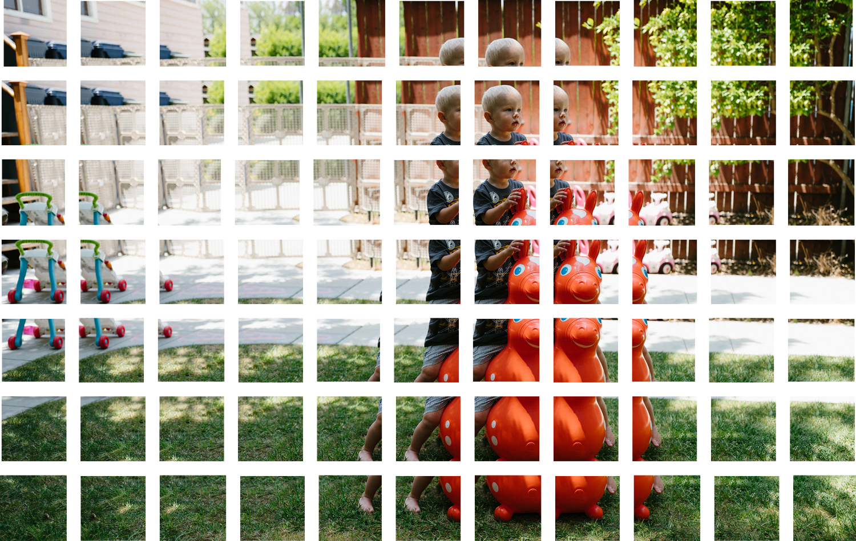
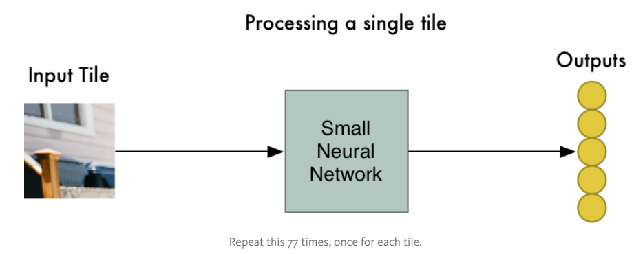
How Convolution Works
Step 1: Break the image into overlapping image tiles
Similar to our sliding window search above, let’s pass a sliding window over the entire original image and save each result as a separate, tiny picture tile
By doing this, we turned our original image into 77 equally-sized tiny image tiles.
Step 2: Feed each image tile into a small neural network
Earlier, we fed a single image into a neural network to see if it was an “8”. We’ll do the exact same thing here, but we’ll do it for each individual image tile.
However, there’s one big twist We’ll keep the same neural network weights for every single tile in the same original image. In other words, we are treating every image tile equally. If something interesting appears in any given tile, we’ll mark that tile as interesting

Slide 10
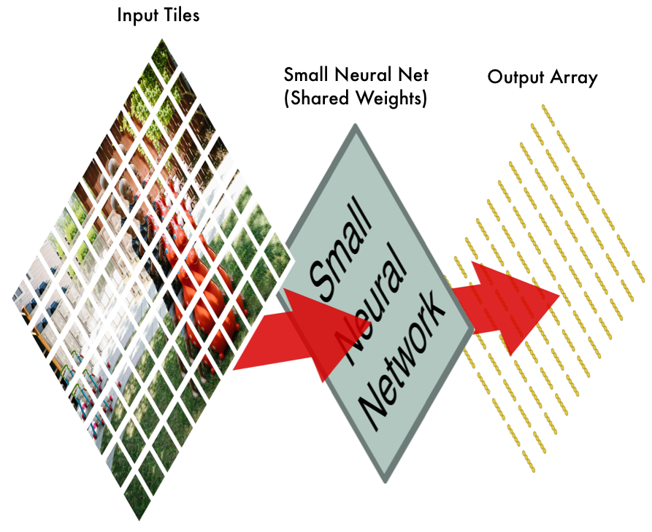
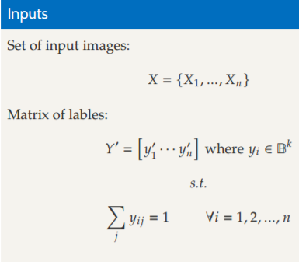
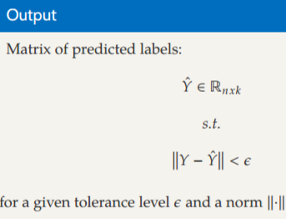
How Convolution Works
Step 3: Save the results from each tile into a new array
We don’t want to lose track of the arrangement of the original tiles. So we save the result from processing each tile into a grid in the same arrangement as the original image. It looks like this,
In other words, we’ve started with a large image and we ended with a slightly smaller array that records which sections of our original image were the most interesting.

Slide 11
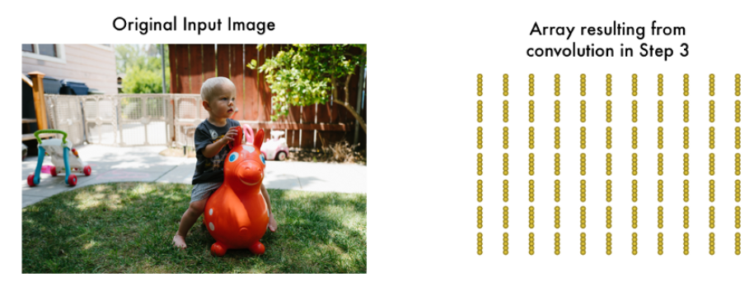
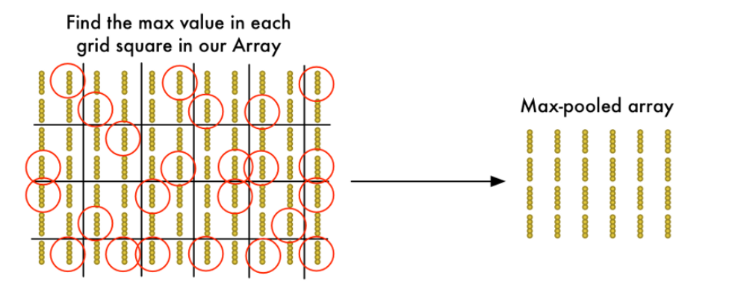
How Convolution Works
Step 4: Downsampling
The result of Step 3 was an array that maps out which parts of the original image are the most interesting. But that array is still pretty big:
To reduce the size of the array, we downsample it using an algorithm called max pooling. It sounds fancy, but it isn’t at all!
We’ll just look at each 2x2 square of the array and keep the biggest number:
The idea here is that if we found something interesting in any of the four input tiles that makes up each 2x2 grid square, we’ll just keep the most interesting bit. This reduces the size of our array while keeping the most important bits.

Slide 12
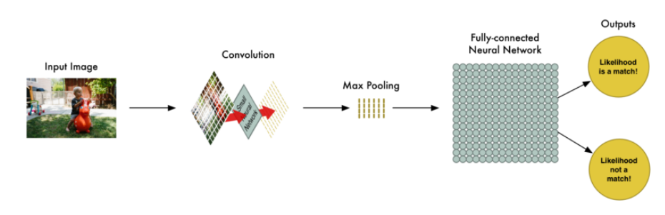
How Convolution Works
Final step: Make a prediction
So far, we’ve reduced a giant image down into a fairly small array.
Guess what? That array is just a bunch of numbers, so we can use that small array as input into another neural network. This final neural network will decide if the image is or isn’t a match. To differentiate it from the convolution step, we call it a “fully connected” network.
So from start to finish, our whole five-step pipeline looks like this:

Slide 13
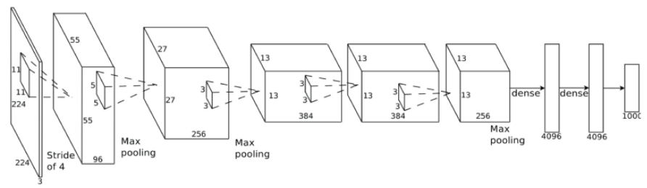
How Convolution Works
Adding Even More Steps
Our image processing pipeline is a series of steps: convolution, max-pooling, and finally a fully-connected network.
When solving problems in the real world, these steps can be combined and stacked as many times as you want! You can have two, three or even ten convolution layers. You can throw in max pooling wherever you want to reduce the size of your data.
The basic idea is to start with a large image and continually boil it down, step-by-step, until you finally have a single result. The more convolution steps you have, the more complicated features your network will be able to learn to recognize.
For example, the first convolution step might learn to recognize sharp edges, the second convolution step might recognize beaks using it’s knowledge of sharp edges, the third step might recognize entire birds using it’s knowledge of beaks, etc.
Here’s what a more realistic deep convolutional network (like you would find in a research paper) looks like:
In this case, they start a 224 x 224 pixel image, apply convolution and max pooling twice, apply convolution 3 more times, apply max pooling and then have two fully-connected layers. The end result is that the image is classified into one of 1000 categories!

Slide 14
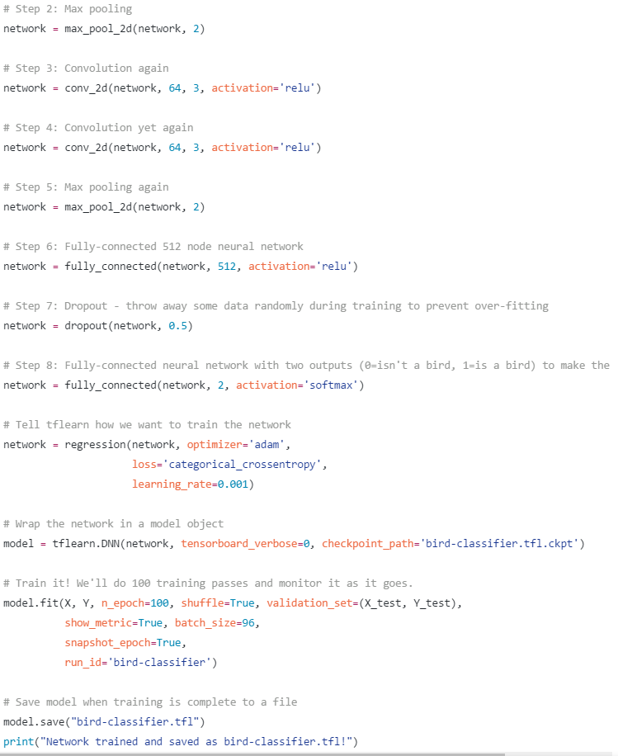
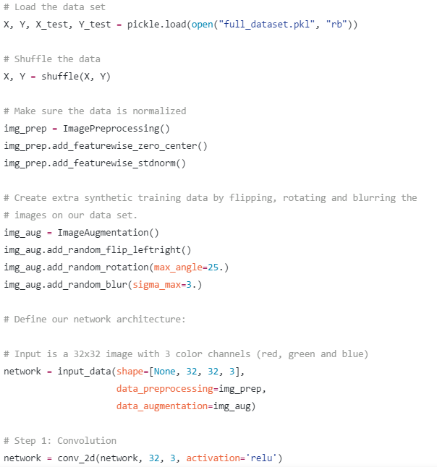
code to define and train the network

Slide 15
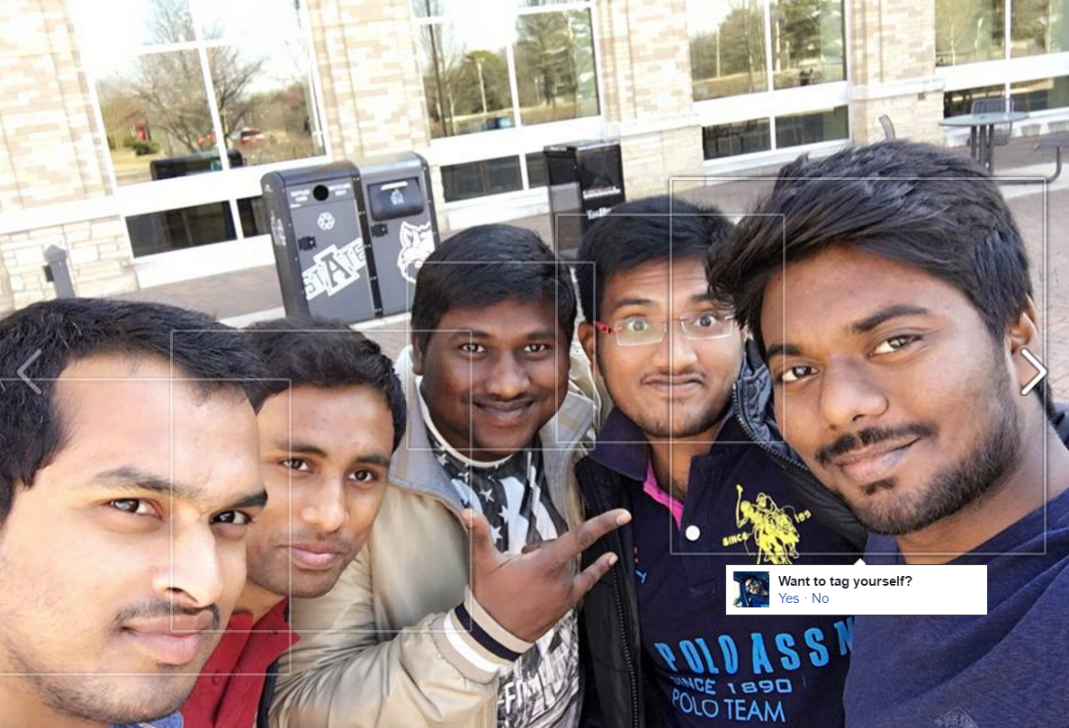
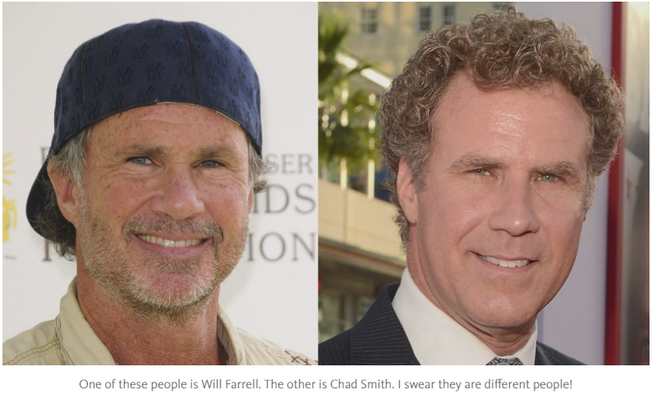
Modern Face Recognition with Deep Learning
Have you noticed that Facebook has developed an uncanny ability to recognize your friends in your photographs? In the old days, Facebook used to make you to tag your friends in photos by clicking on them and typing in their name. Now as soon as you upload a photo, Facebook tags everyone for you like magic.
This technology is called face recognition. Facebook’s algorithms are able to recognize your friends’ faces after they have been tagged only a few times. It’s pretty amazing technology — Facebook can recognize faces with 98% accuracy which is pretty much as good as humans can do!
Let’s learn how modern face recognition works! But just recognizing your friends would be too easy. We can push this tech to the limit to solve a more challenging problem — telling Will Ferrell (famous actor) apart from Chad Smith (famous rock musician)!

Slide 16

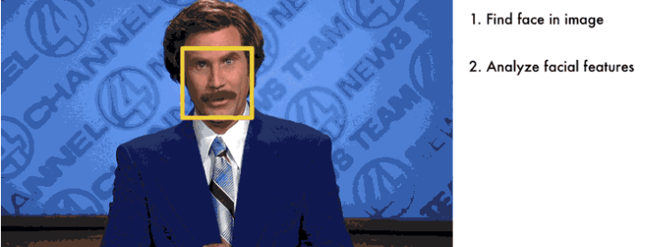
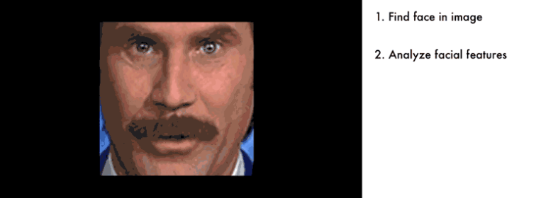
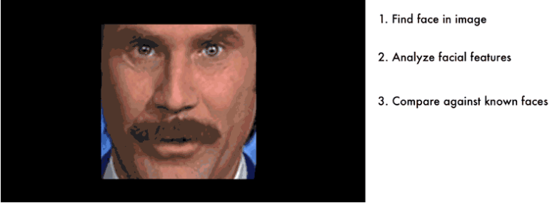
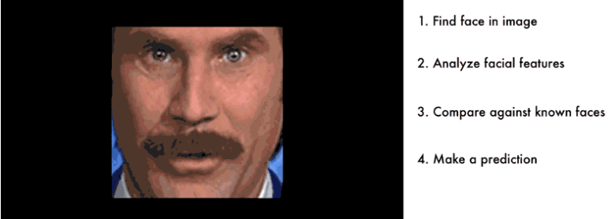
How to use Machine Learning on a Very Complicated Problem
face recognition is really a series of several related problems:
First, look at a picture and find all the faces in it
Second, focus on each face and be able to understand that even if a face is turned in a weird direction or in bad lighting, it is still the same person.
Third, be able to pick out unique features of the face that you can use to tell it apart from other people— like how big the eyes are, how long the face is, etc.
Finally, compare the unique features of that face to all the people you already know to determine the person’s name.
We need to build a pipeline where we solve each step of face recognition separately and pass the result of the current step to the next step. In other words, we will chain together several machine learning algorithms:

Slide 17
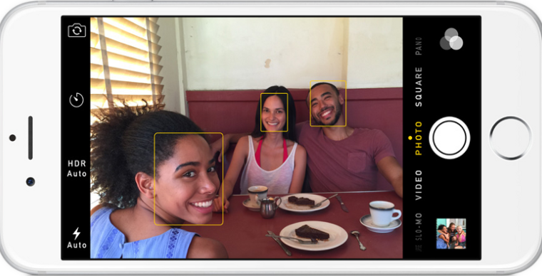
Face Recognition — Step by Step
Step 1: Finding all the Faces
The first step in our pipeline is face detection. Obviously we need to locate the faces in a photograph before we can try to tell them apart!
If you’ve used any camera in the last 10 years, you’ve probably seen face detection in action
Face detection is a great feature for cameras. When the camera can automatically pick out faces, it can make sure that all the faces are in focus before it takes the picture. But we’ll use it for a different purpose — finding the areas of the image we want to pass on to the next step in our pipeline.

Slide 18

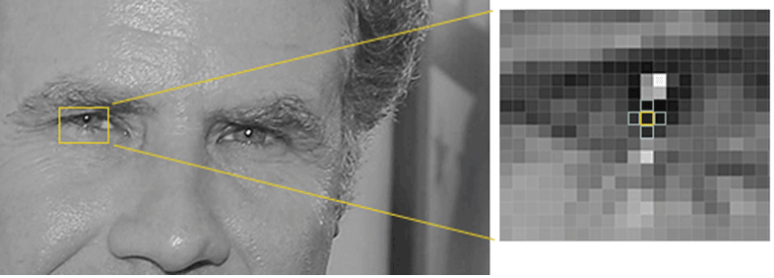
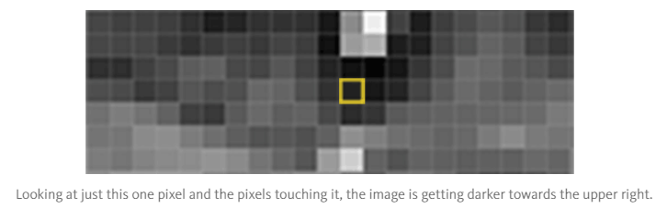
Face Recognition — Step by Step
To find faces in an image, we’ll start by making our image black and white because we don’t need color data to find faces
Then we’ll look at every single pixel in our image one at a time. For every single pixel, we want to look at the pixels that directly surrounding it
Our goal is to figure out how dark the current pixel is compared to the pixels directly surrounding it. Then we want to draw an arrow showing in which direction the image is getting darker

Slide 19
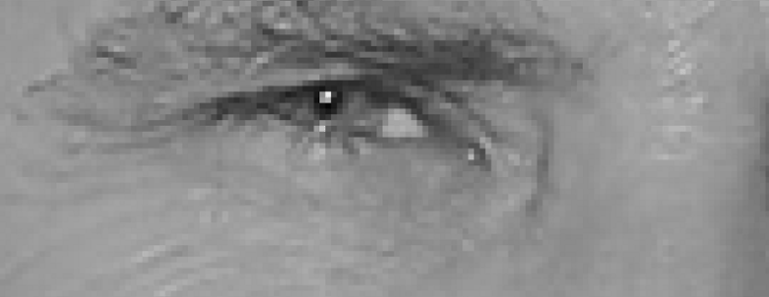


Face Recognition — Step by Step
If you repeat that process for every single pixel in the image, you end up with every pixel being replaced by an arrow. These arrows are called gradients and they show the flow from light to dark across the entire image.
This might seem like a random thing to do, but there’s a really good reason for replacing the pixels with gradients. If we analyze pixels directly, really dark images and really light images of the same person will have totally different pixel values. But by only considering the direction that brightness changes, both really dark images and really bright images will end up with the same exact representation. That makes the problem a lot easier to solve.
But saving the gradient for every single pixel gives us way too much detail. We end up missing the forest for the trees. It would be better if we could just see the basic flow of lightness/darkness at a higher level so we could see the basic pattern of the image.
To do this, we’ll break up the image into small squares of 16x16 pixels each. In each square, we’ll count up how many gradients point in each major direction (how many point up, point up-right, point right, etc…). Then we’ll replace that square in the image with the arrow directions that were the strongest.

Slide 20
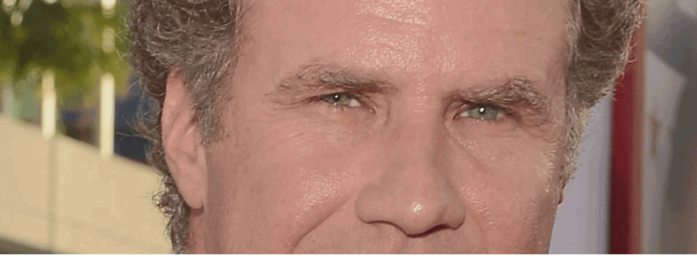
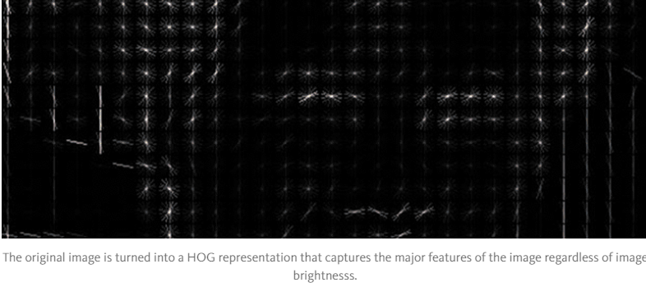
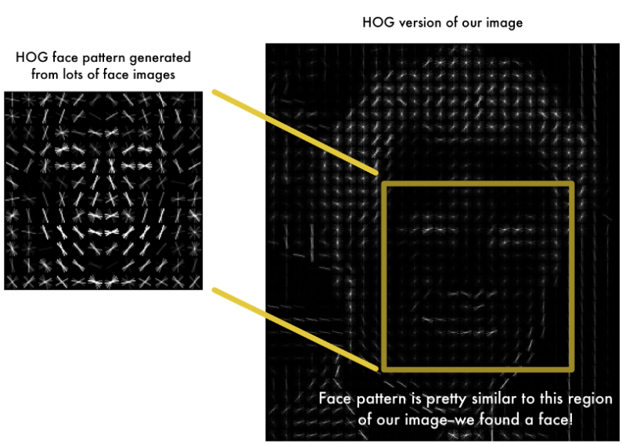
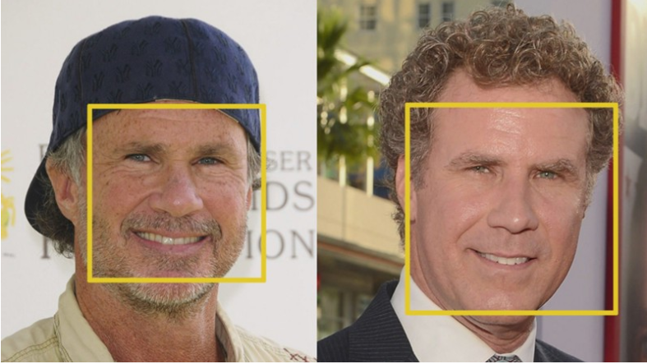
Face Recognition — Step by Step
The end result is we turn the original image into a very simple representation that captures the basic structure of a face in a simple way.
To find faces in this HOG image, all we have to do is find the part of our image that looks the most similar to a known HOG pattern that was extracted from a bunch of other training faces.
To find faces in this HOG image, all we have to do is find the part of our image that looks the most similar to a known HOG pattern that was extracted from a bunch of other training faces.
Using this technique, we can now easily find faces in any image.

Slide 21

Face Recognition — Step by Step
If you want to try this step out using Python and dlib, code showing how to generate and view HOG representations of images after the final step.

Slide 22
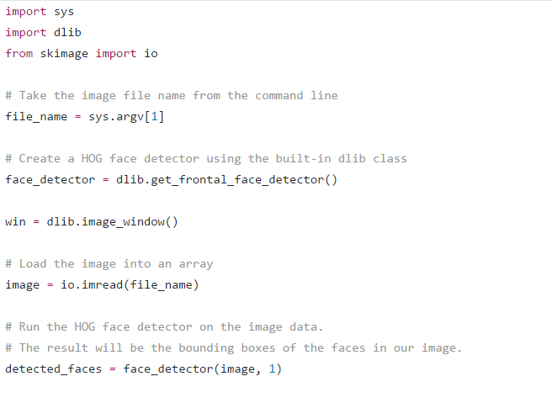
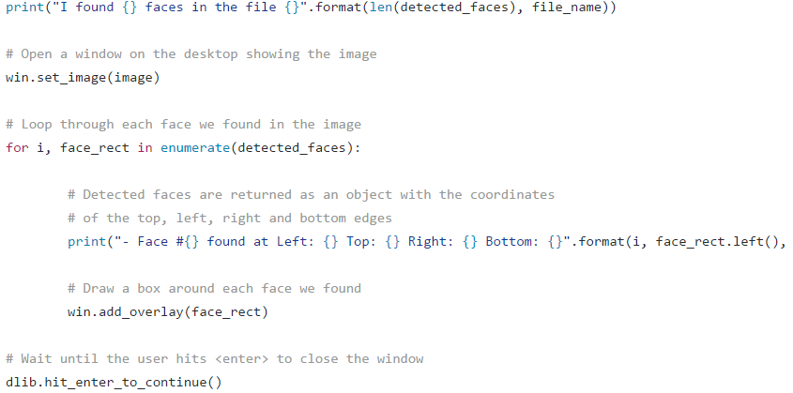
Face Recognition — Step by Step

Slide 23
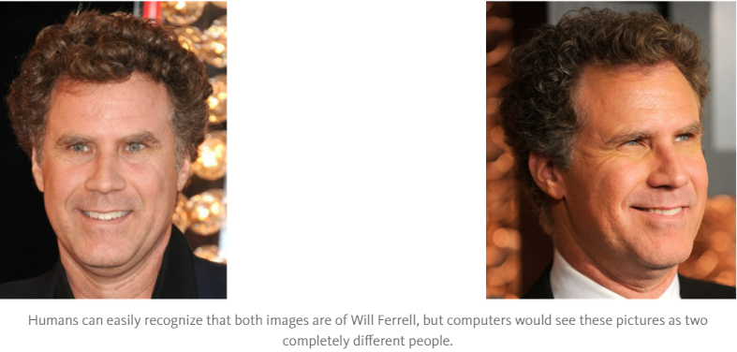
Face Recognition — Step by Step
Step 2: Posing and Projecting Faces
Whew, we isolated the faces in our image. But now we have to deal with the problem that faces turned different directions look totally different to a computer.
To account for this, we will try to warp each picture so that the eyes and lips are always in the sample place in the image. This will make it a lot easier for us to compare faces in the next steps.
To do this, we are going to use an algorithm called face landmark estimation. There are lots of ways to do this, but we are going to use the approach invented in 2014 by Vahid Kazemi and Josephine Sullivan.

Slide 24
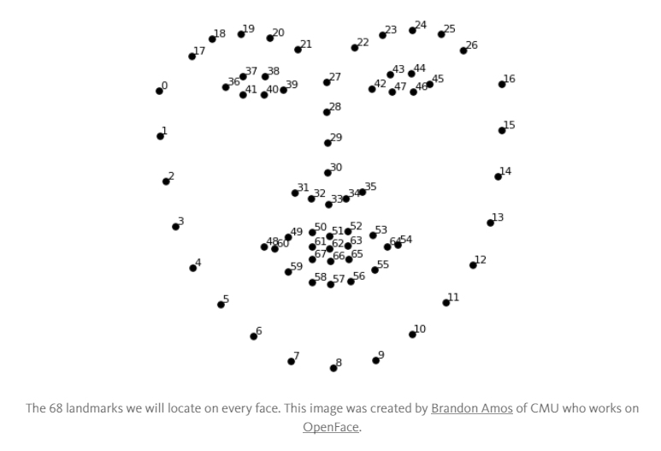
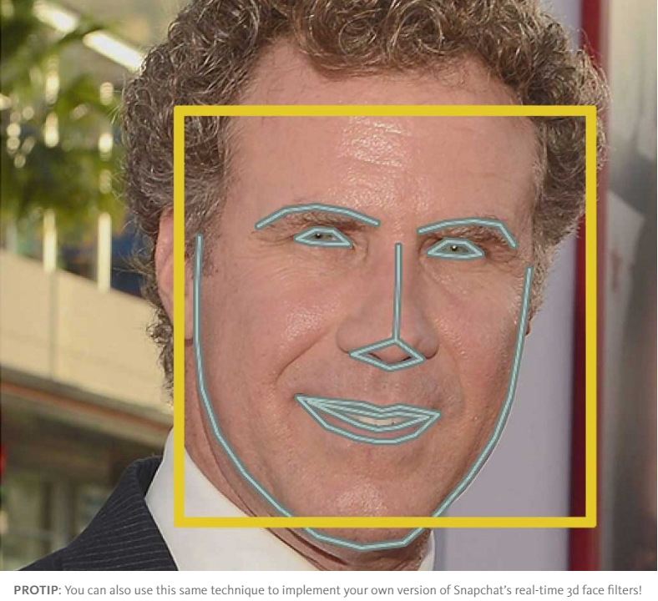
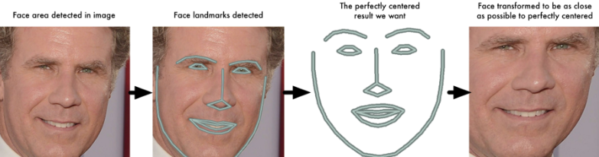
Face Recognition — Step by Step
The basic idea is we will come up with 68 specific points (called landmarks) that exist on every face — the top of the chin, the outside edge of each eye, the inner edge of each eyebrow, etc. Then we will train a machine learning algorithm to be able to find these 68 specific points on any face.
Here’s the result of locating the 68 face landmarks on our test image.
Now that we know were the eyes and mouth are, we’ll simply rotate, scale and shear the image so that the eyes and mouth are centered as best as possible. We won’t do any fancy 3d warps because that would introduce distortions into the image. We are only going to use basic image transformations like rotation and scale that preserve parallel lines.
Now no matter how the face is turned, we are able to center the eyes and mouth are in roughly the same position in the image. This will make our next step a lot more accurate.

Slide 25
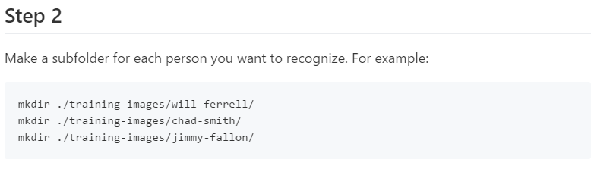
Face Recognition — Step by Step
If you want to try this step out using Python and dlib, here’s the code for finding face landmarks and here’s the code for transforming the image using those landmarks.

Slide 26
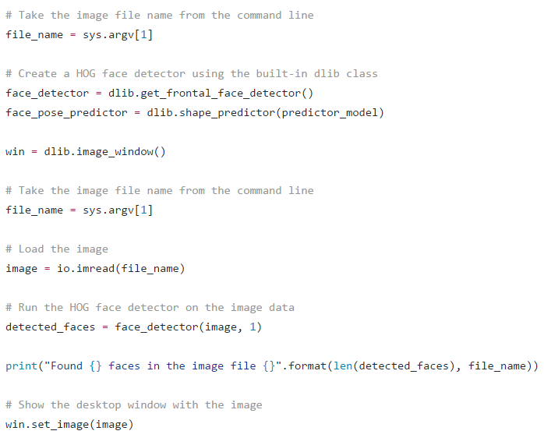
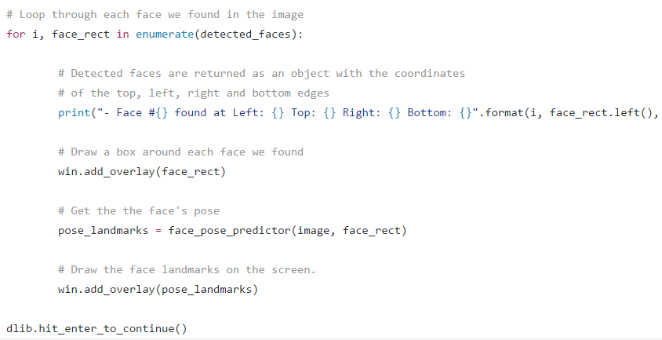
Face Recognition — Step by Step

Slide 27
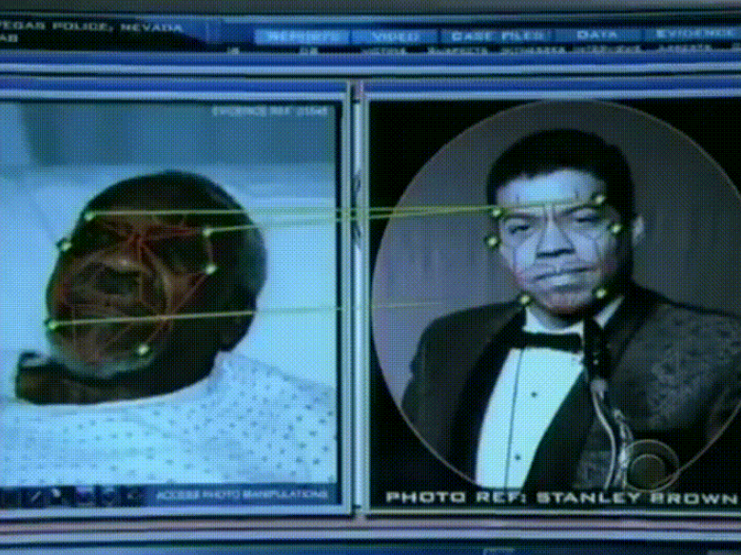
Face Recognition — Step by Step
Step 3: Encoding Faces
Now we are to the meat of the problem — actually telling faces apart.
The simplest approach to face recognition is to directly compare the unknown face we found in Step 2 with all the pictures we have of people that have already been tagged. When we find a previously tagged face that looks very similar to our unknown face, it must be the same person.
There’s actually a huge problem with that approach. A site like Facebook with billions of users and a trillion photos can’t possibly loop through every previous-tagged face to compare it to every newly uploaded picture. That would take way too long. They need to be able to recognize faces in milliseconds, not hours.
What we need is a way to extract a few basic measurements from each face. Then we could measure our unknown face the same way and find the known face with the closest measurements. For example, we might measure the size of each ear, the spacing between the eyes, the length of the nose, etc. If you’ve ever watched a bad crime show like CSI, you know what I am talking about.

Slide 28
Face Recognition — Step by Step
The most reliable way to measure a face
Ok, so which measurements should we collect from each face to build our known face database? Ear size? Nose length? Eye color? Something else?
It turns out that the measurements that seem obvious to us humans (like eye color) don’t really make sense to a computer looking at individual pixels in an image. Researchers have discovered that the most accurate approach is to let the computer figure out the measurements to collect itself. Deep learning does a better job than humans at figuring out which parts of a face are important to measure.
The solution is to train a Deep Convolutional Neural Network (just like we did in Part 3). But instead of training the network to recognize pictures objects like we did last time, we are going to train it to generate 128 measurements for each face.
The training process works by looking at 3 face images at a time:
Load a training face image of a known person
Load another picture of the same known person
Load a picture of a totally different person

Slide 29
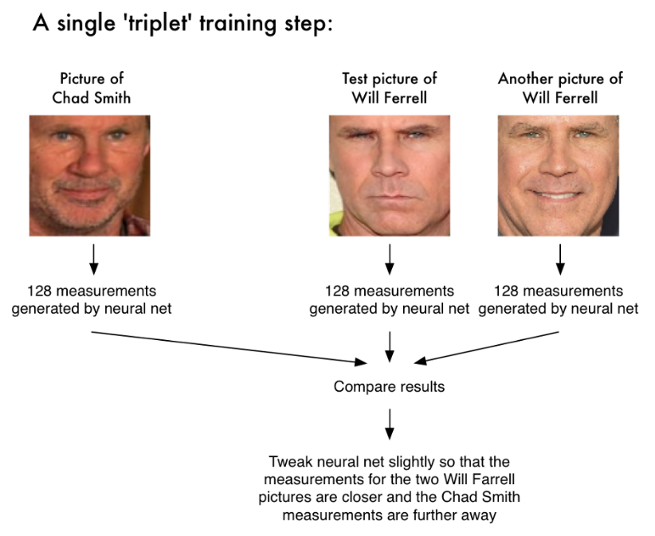
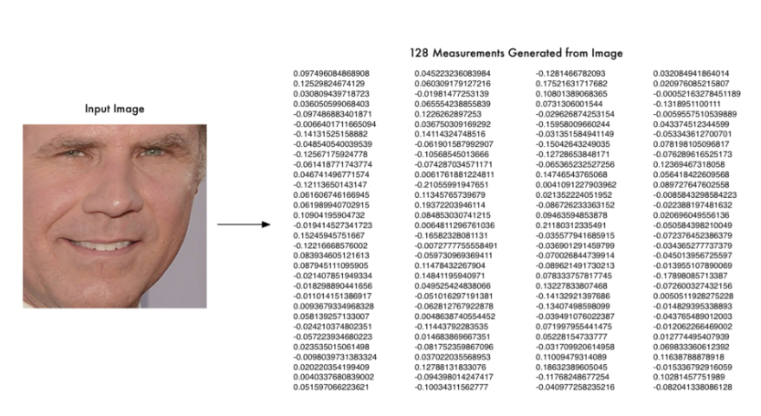
Face Recognition — Step by Step
After repeating this step millions of times for millions of images of thousands of different people, the neural network learns to reliably generate 128 measurements for each person. Any ten different pictures of the same person should give roughly the same measurements.
Machine learning people call the 128 measurements of each face an embedding. The idea of reducing complicated raw data like a picture into a list of computer generated numbers comes up a lot in machine learning (especially in language translation). The exact approach for faces we are using was invented in 2015 by researchers at Google but many similar approaches exist.
Encoding our face image
It can generate measurements for any face, even ones it has never seen before! So this step only needs to be done once. Lucky for us, the fine folks at OpenFace already did this and they published several trained networks which we can directly use. Thanks Brandon Amos and team.
So all we need to do ourselves is run our face images through their pre-trained network to get the 128 measurements for each face. Here’s the measurements for our test image.

Slide 30
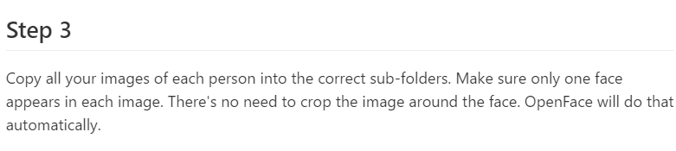
Face Recognition — Step by Step
So what parts of the face are these 128 numbers measuring exactly? It turns out that we have no idea. It doesn’t really matter to us. All that we care is that the network generates nearly the same numbers when looking at two different pictures of the same person.
If you want to try this step yourself, OpenFace provides a lua script that will generate embeddings all images in a folder and write them to a csv file. You run it like this.

Slide 31
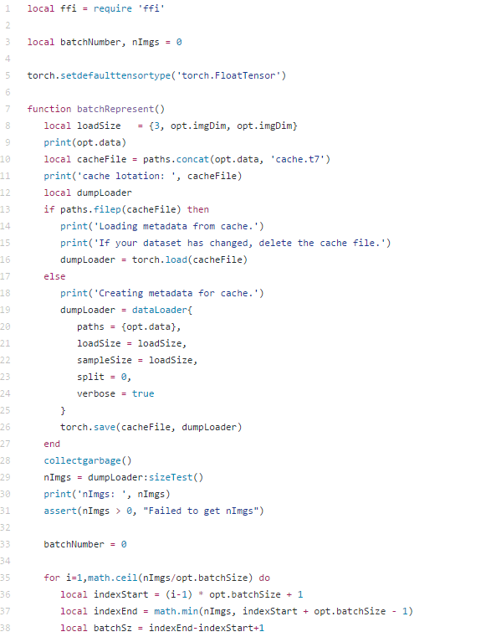
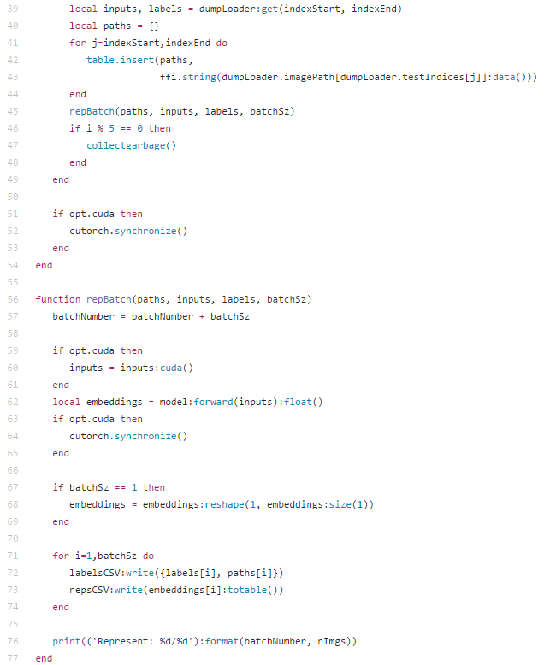
Face Recognition — Step by Step

Slide 32
Face Recognition — Step by Step
Step 4: Finding the person’s name from the encoding
This last step is actually the easiest step in the whole process. All we have to do is find the person in our database of known people who has the closest measurements to our test image.
You can do that by using any basic machine learning classification algorithm. No fancy deep learning tricks are needed. We’ll use a simple linear SVM classifier, but lots of classification algorithms could work.
All we need to do is train a classifier that can take in the measurements from a new test image and tells which known person is the closest match. Running this classifier takes milliseconds. The result of the classifier is the name of the person!

Slide 33
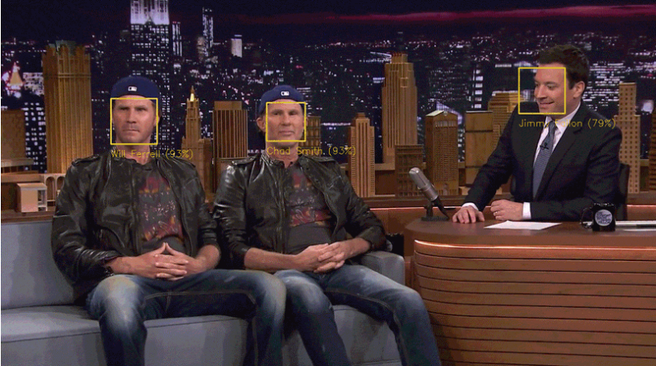

Face Recognition — Step by Step
So let’s try out our system. First, I trained a classifier with the embeddings of about 20 pictures each of Will Ferrell, Chad Smith and Jimmy Falon.
After running the classifier on every frame of Will Ferrell and Chad Smith pretending to be each other on the Jimmy Fallon show.
It works! And look how well it works for faces in different poses even sideways faces.

Slide 34


Face Recognition — Step by Step

Slide 35
Face Recognition — Step by Step
Running this Yourself
Encode a picture using the HOG algorithm to create a simplified version of the image. Using this simplified image, find the part of the image that most looks like a generic HOG encoding of a face.
Figure out the pose of the face by finding the main landmarks in the face. Once we find those landmarks, use them to warp the image so that the eyes and mouth are centered.
Pass the centered face image through a neural network that knows how to measure features of the face. Save those 128 measurements.
Looking at all the faces we’ve measured in the past, see which person has the closest measurements to our face’s measurements. That’s our match!

Slide 36
Conclusion
Deep learning framework for face detection with carefully designed pre-training strategies, our method is robust to background clutters and face variations. We devise a new fast Brute Force algorithm by using Sliding Window Technique for locally shared filters to save redundant computation, which enables evaluating image with arbitrary size in realtime. It allows taking images of arbitrary sizes as input without normalization. We have also revealed multiple important facts about learning face representation, which shed a light on new directions of face detection and representation learning.

Slide 37
References
https://medium.com/@ageitgey/machine-learning-is-fun-part-4-modern-face-recognition-with-deep-learning-c3cffc121d78#.2n6j41y9r
https://medium.com/@ageitgey/machine-learning-is-fun-80ea3ec3c471#.rkuqcwomp
Jiaojiao Zhao, Key Lab. of Intell. Perception & Image Understanding of Minist. of Educ. of China, Xidian Univ., Xi'an, China.
http://ieeexplore.ieee.org/document/6889510/?reload=true
Y. LeCun, Y. Bengio, and G. Hinton, “Deep learning,” Nature, vol. 521, no. 7553, pp. 436–444, 2015.
K. Simonyan and A. Zisserman, “Very Deep Convolutional Networks for Large-Scale Image Recognition,” Proceedings of the ICLR, pp. 1–14, 2015.
G, Hinton, S. Osindero, and Y. Teh, “A Fast Learning Algorithm for Deep Belief Nets,” Neural Computation, vol. 18, no. 7, pp. 1527–54, 2006.
M. D. Zeiler and R. Fergus, “Visualizing and understanding convolutional networks,” in Proceedings of the ECCV International Workshop on Statistical Learning in Computer Vision. Springer, 2014, pp. 818– 833.
Larry Brown Ph.D., GEOINT Training, larryb@nvidia.com, http://www.nvidia.com/content/events/geoInt2015/LBrown_DL_Image_ClassificationGEOINT.pdf
http://www.iro.umontreal.ca/~memisevr/talks/memisevicIcisp2016.pdf
D. Novotny, “Large Scale Object Detection,” Ph.D. dissertation, Czech Technical University, 2014.
L. Deng, “A tutorial survey of architectures, algorithms, and applications for deep learning,” APSIPA Transactions on Signal and Information Processing, vol. 3, no. January, p. e2, 2014.

